Slide 1


7143CEM Mini-lecture 3-3a: Data Protection
School of Computing, Electronics and Mathematics Coventry University
7143CEM Programming for Data Science 2021/22 Semester 2

Slide 2
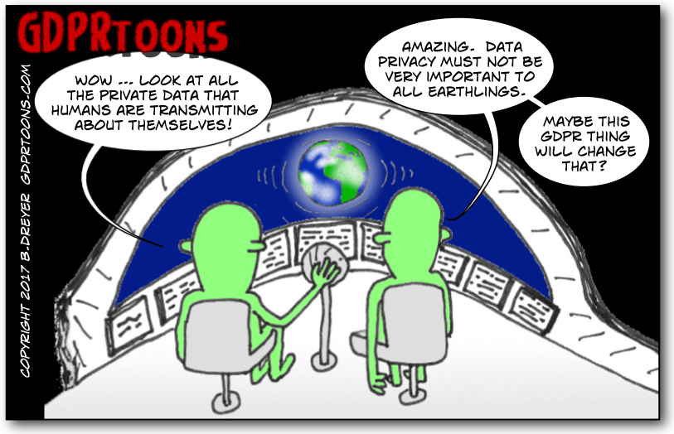
What is Data Protection?
Fair and responsible use of information about people.
Protecting the fundamental right to privacy.
Build trust between people and organisations.
If you collect information about individuals for any reason other than your own personal, family or household purposes, you need to comply with data protection law.
Notes:
Source: https://ico.org.uk/for-organisations/guide-to-data-protection/introduction-to-data-protection/some-basic-concepts/
Cartoons from: http://www.gdprtoons.com/

Slide 3
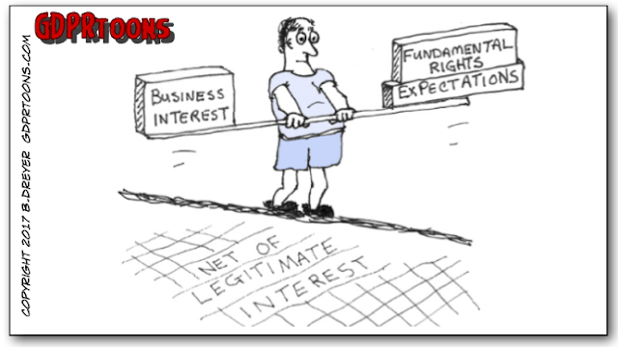
Data Protection (Law)
European Union / United Kingdom General Data Protection Regulation (GDPR)
Data controller, data processor, data subject
Require informed consent from data subject or must have a legal basis for processing data
UK Data Protection Act 2018
Implements GDPR in the UK (from 25 May 2018)
Data protection principles
Sensitive information
Notes:
Reading: https://www.hutsix.io/what-are-the-eight-principles-of-the-data-protection-act/
Cartoons from: http://www.gdprtoons.com/

Slide 4
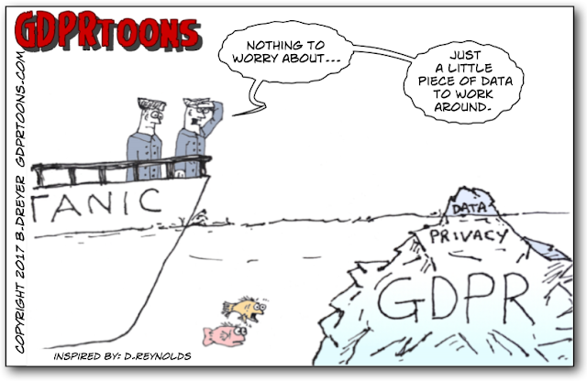
Personal Data
Personal data means information about a particular living individual that can be used identify them (directly or indirectly), including:
Name, address, date of birth, ID numbers, email address, etc.
User-generated data, e.g., social media posts
Personal images and photos
Records (medical, financial, educational, membership of organisations such as trade unions)
IP addresses, location data, and search histories
Notes:
Source: https://www.congruity360.com/data-under-gdpr/

Slide 5
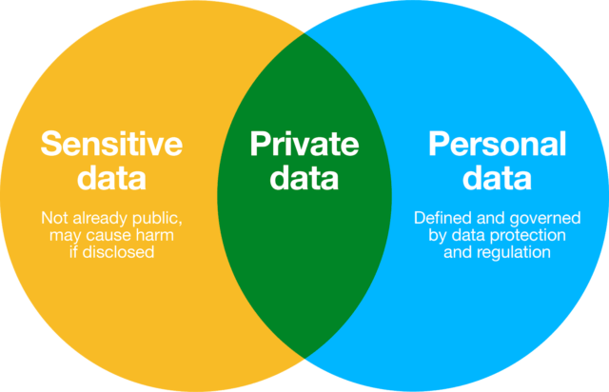
Sensitive Data
Sensitive data is a set of special categories that requires extra security measures.
race or ethnic background
political opinions
religious or philosophical beliefs
trade union membership
genetics, biometrics (where used for identification), e.g., fingerprint scans, facial recognition software, lab samples, DNA
Notes:
Source: https://www.gov.uk/data-protection
Image from: https://fortis-dpc.com/gdpr/personal-data-and-sensitive-data/

Slide 6
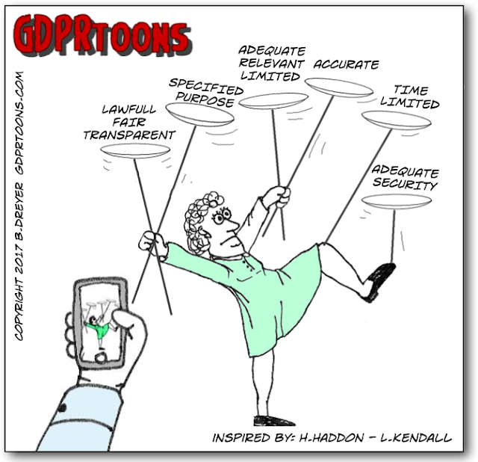
Data Protection Principles
Lawfulness, fairness and transparency
Purpose limitation (specified)
Data minimisation (necessary)
Accuracy
Storage limitation (current, expires)
Integrity and confidentiality (security)
Accountability
Notes:
Source: https://www.gov.uk/data-protection
Cartoon from: http://www.gdprtoons.com/

Slide 7
Processing Data
The law applies to “processing of personal data”.
Processing includes almost anything you do with data, e.g., collecting, recording, storing, using, analysing, combining, disclosing or deleting it.
A data controller is the person or organisation that decides how and why to collect and use the data.
A data processor is a separate person or organisation (not an employee) who processes data on behalf of the controller and in accordance with their instructions.
Notes:
Source: https://www.gov.uk/data-protection

Slide 8
Basis for Processing Data
At least one of these must apply to process personal data:
Consent – individual gives consent to process personal data for a specific purpose, e.g., tracking/advertising cookies
Contract – necessary for a contract with the individual
Legal obligation – necessary to comply with the law
Vital interests – necessary to protect someone’s life
Public task – necessary for the public interest or official function (lawful)
Legitimate interests – to benefit of your organisation (purpose) in a way that your users would reasonably expect (necessary), with minimal risk and impact on individuals (balancing), e.g., fraud prevention, employee or client data
Notes:
Source: https://www.gov.uk/data-protection

Slide 9
Consent
Ask for consent where you are offering a genuine choice over a non-essential service.
Consent must be:
Freely given – person must not be pressured into giving consent or suffer any detriment if they refuse.
Specific – person must be asked to consent to individual types of data processing.
Informed – person must be told what they're consenting to.
Unambiguous – language must be clear and simple.
Clear affirmative action – person must expressly consent by doing or saying something.
Notes:
Source: https://www.gov.uk/data-protection

Slide 10
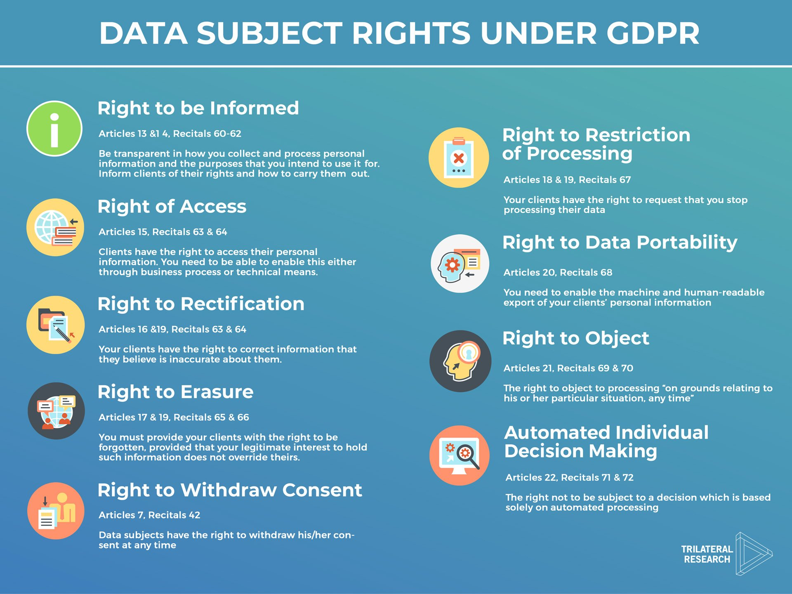
Rights of Individuals
Notes:
Source: https://www.trilateralresearch.com/celebrating-data-protection-day/

Slide 11
Discussion of Scenarios
Staff management and payroll administration
Access to or consultation of a contacts database containing personal data
Sending promotional emails
Shredding documents containing personal data
Posting a photo of a person on a website
Storing IP addresses or MAC addresses
Video recording (CCTV)

Slide 12
Discussion
If an employee is absent can we still access their inbox?
I wanted a manager’s email address and was told by another manager that I couldn’t have it due to GDPR.
Our company has scrapped all dash-cams due to data protection. Is this needed?
We ask for emergency contacts when staff join us, do we need their consent to have their details?
If the website has a sales@ email address, do I need consent to contact them?
Notes:
Source: https://www.beswicks.com/top-5-questions-that-show-gdpr-has-already-driven-the-world-crazy/

Slide 13
Discussion
During the sales process, a customer may request more information or sign up for a trial, which may require the processing of personal data like credit card information or contact information.
Information from accident reports require processing for health and safety records.
Using photos of school students on a school website.
Notes:
Source: https://blog.focal-point.com/9-examples-of-lawful-basis-for-processing-under-the-gdpr

Slide 14
Summary
Legal requirements for processing of personal data
GDPR and UK Data Protection Act 2018
Personal (could used to identify) and sensitive data (kept private)
Data protection principles (lawful/fair/transparent, specified purpose, expires, necessary, accurate, etc) Basis for processing data (consent is only one of these)
Rights of individuals (informed, access, forgotten, etc)

